Slide 1
Referrals to Children’s Mental Health Services
Children age 2 through 17
Resident in Grampian
Referred to CAMHS
Including rejected referrals
From 1 January 2015 and 31 October 2021

Slide 2
22,000 referrals
15,000 people referred

Slide 3
Section 1
Who gets referred?

Slide 4
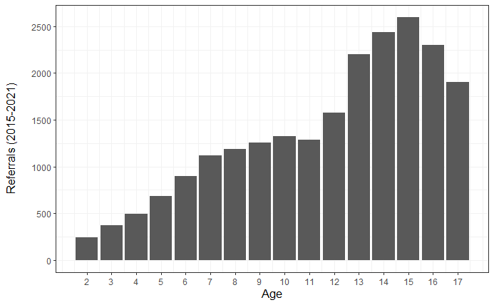
Referrals rise steeply during secondary school
referrals_by_age.csv

Slide 5
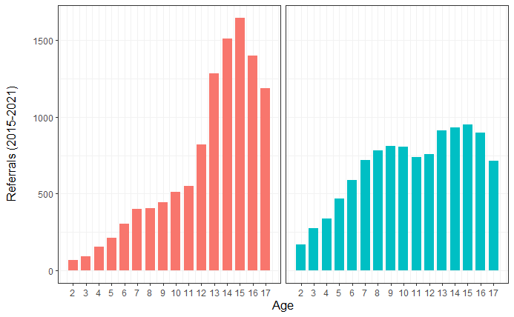
Girls referred much more often than boys in secondary
referrals_by_age_sex.csv

Slide 6
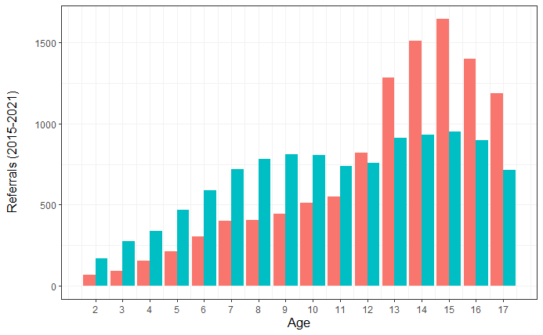
Boys referred much more often than girls in primary
referrals_by_age_sex.csv

Slide 7
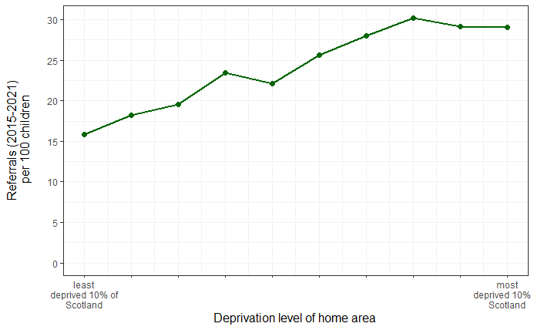
Referrals rise steeply as socioeconomic deprivation increases
referrals_by_simd.csv

Slide 8
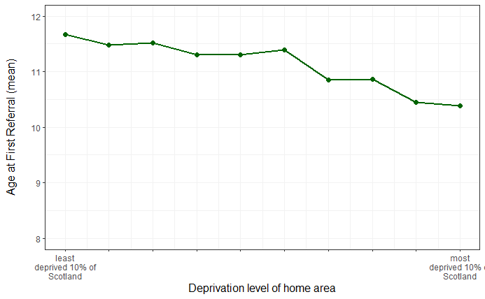
Children from deprived areas are younger when first referred
referrals_by_simd_age.csv

Slide 9
Section 2
How have referrals
changed over time?

Slide 10
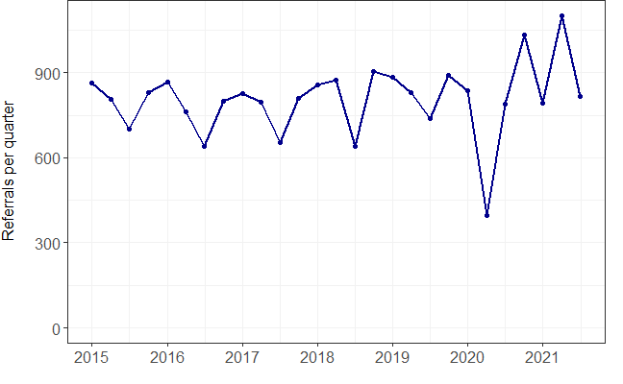
Referral rate was steady with a seasonal pattern
referrals_by_quarter.csv

Slide 11
Referrals have risen about 20% since October 2020
referrals_by_quarter.csv

Slide 12
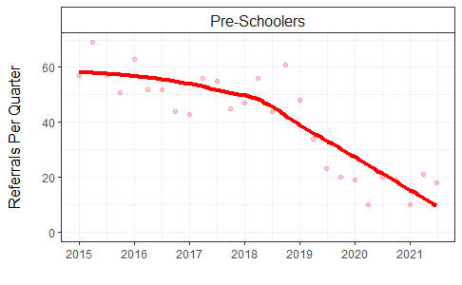
Referrals for the youngest children have dropped steeply
referrals_by_quarter_school.csv

Slide 13
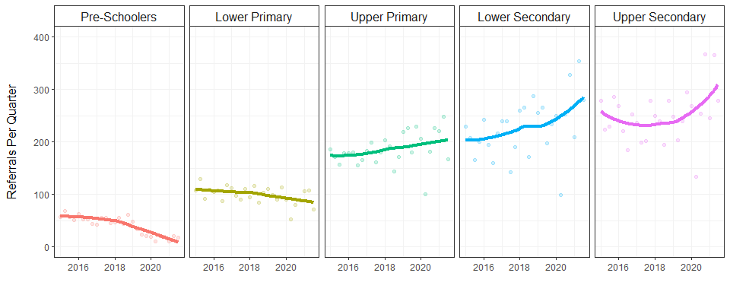
Referrals for secondary school children have risen steeply
referrals_by_quarter_school.csv

Slide 14
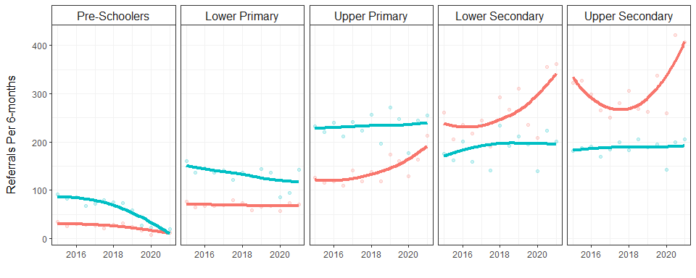
Pre-school decrease due to fewer boys referred
Secondary school increase due to many more girls referred
referrals_by_halfyear_school_sex.csv

Slide 15
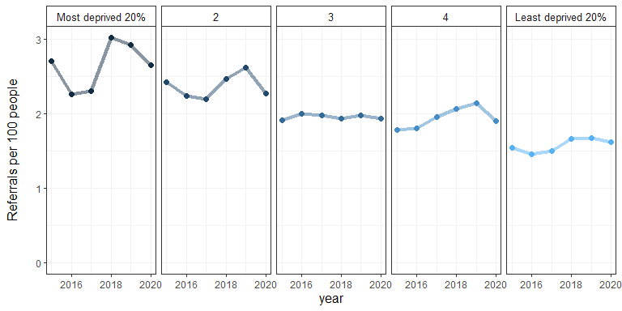
Referral rates are consistently lower among the less deprived
referrals_by_simd_year.csv

Slide 16
Section 3
Whose referrals
get rejected?

Slide 17
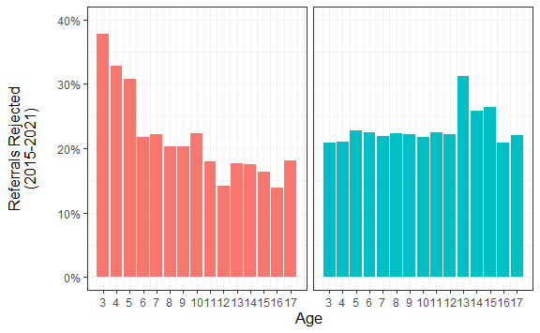
Girls are rejected much more when they are young
Boys are rejected more from age 13 to 15
rejections_by_age_sex.csv

Slide 18
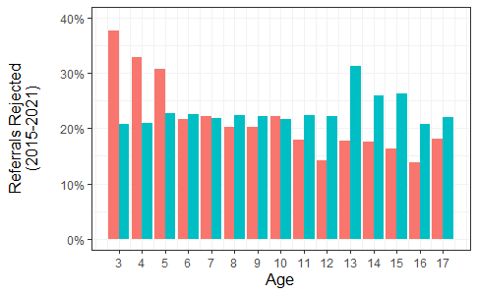
Younger girls are rejected much more than boys
Older boys are rejected much more girls
rejections_by_age_sex.csv

Slide 19
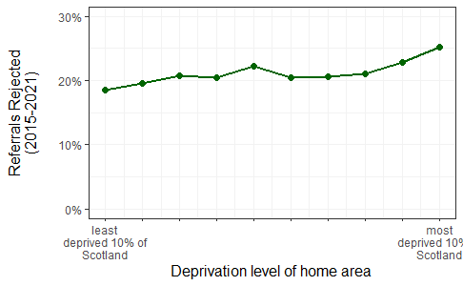
Those living in the most deprived areas are rejected most
rejections_by_simd.csv

Slide 20
Section 4
How have rejections
changed over time?

Slide 21
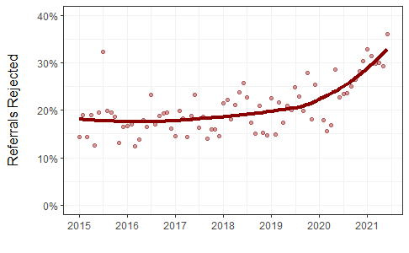
Rejections have risen 70%
rejections_by_month.csv

Slide 22
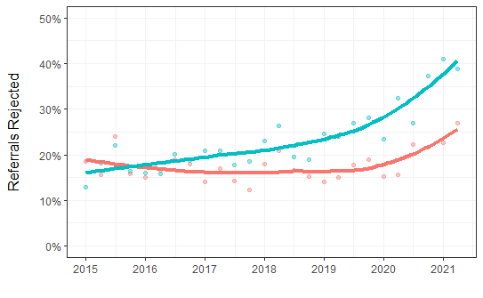
Boys are now rejected much more than girls
rejections_by_quarter_sex.csv

Slide 23
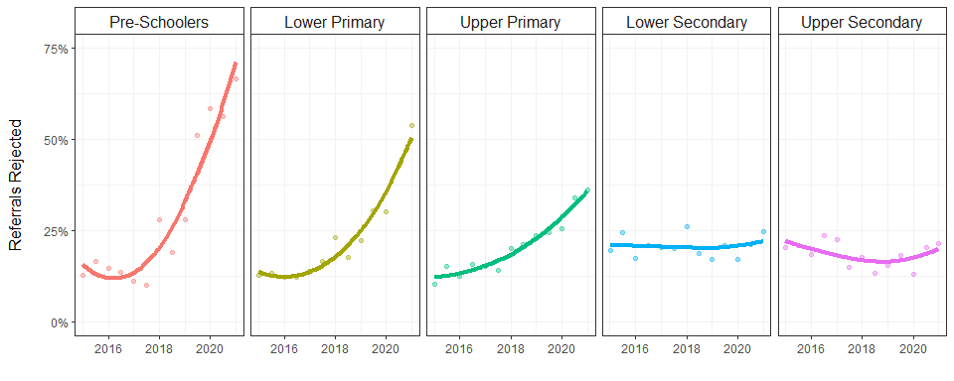
Rejections have increased steeply for children under 12
rejections_by_halfyear_school.csv

Slide 24
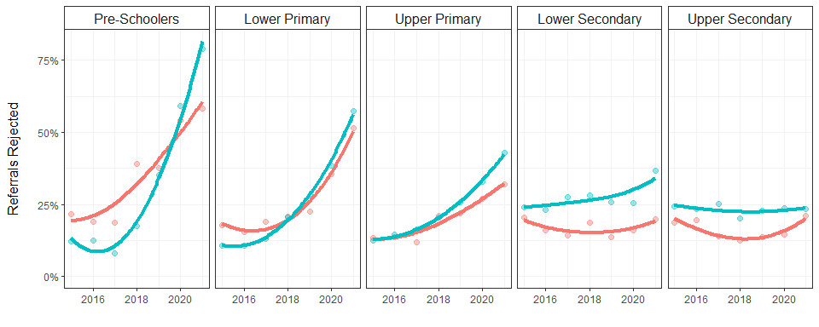
Younger girls used to be rejected more – now rejected less
Secondary school boys have consistently been rejected more
rejections_by_year_school_sex.csv

Slide 25
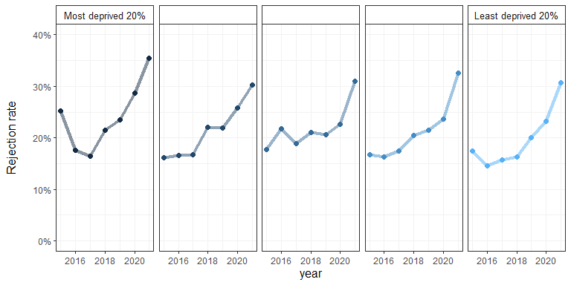
Rejections have risen steeply across all levels of deprivation
rejections_by_simd_year.csv

Slide 26
Who is getting treated?

Slide 27
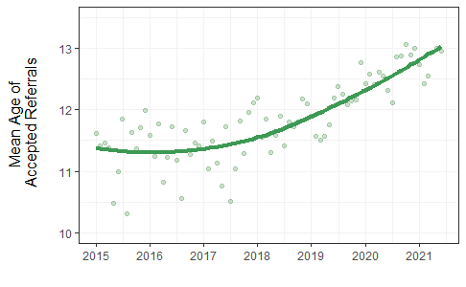
Younger children are being referred less and rejected more,
creating a strong trend to treat older children
age_accepted_by_month.csv

Slide 28
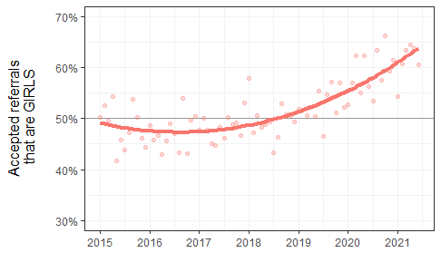
Boys are being referred less and rejected more,
creating a strong trend to treat more girls
girls_accepted_by_month_sex.csv

Slide 29
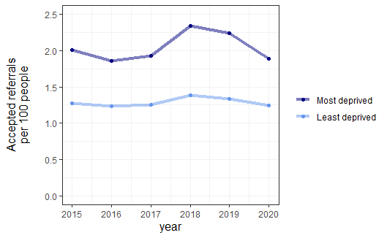
The most deprived are referred much more,
and despite a higher rejection rate, remain highly treated
simd_accepted_by_year.csv

Slide 31
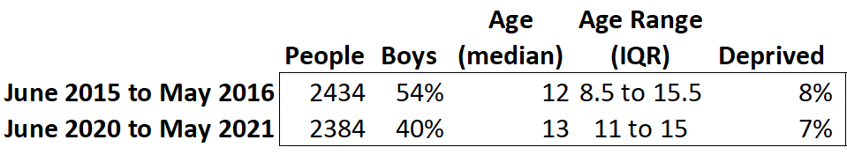
Changes over 5 years to the treated population

